Slide 1

MSDS 432 Group 4 Project
Spring Quarter 2022
Adekunle Adio, Parker Johnson, Corey Lester, Tori Sosnowski

Slide 2
Problem Statement
ABC Incorporated offers a streaming entertainment service to their customers. Given ABC’s customers’ commitment to their product is heavily dependent on discretionary income, they’re concerned the recent rise in prices of essential goods will lead to a significant reduction of their consumer base.
To get a handle of the magnitude of their exposure, ABC is looking to pull inflation data by geographical region in the United States. This information may help determine whether a subset of their customer base is more impacted by essential good inflation than others.

Slide 3
Desired Outcome
Pull data from various federal sources including the Bureau of Labor Statistics as well as FRED (St. Louis Federal Reserve Economic Data) and build a data model for ABC Incorporated to review and analyze the inflation index for various goods within various regions of the country.

Slide 4




Path Taken to Desired Outcome
Pull data from BLS into Microsoft Excel: Link
Pivot data moving evaluation date to rows with other data dimensions leaving the inflation index value in it’s own row
Load Excel files as CSVs into a GitHub repository: Link
Clone GitHub repository to Google Colab for shared EDA: Link
Load CSV files into Microsoft Azure to build and host a SQL server data model

Slide 5
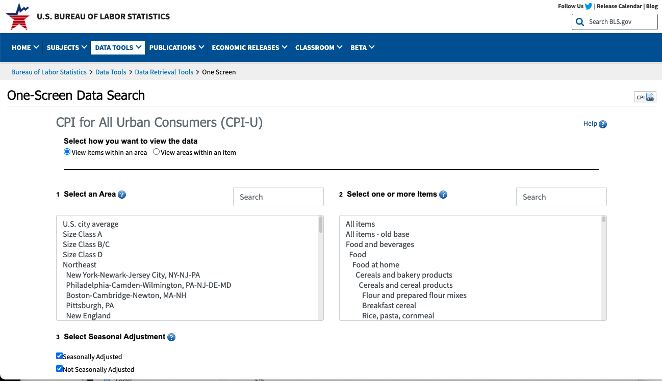
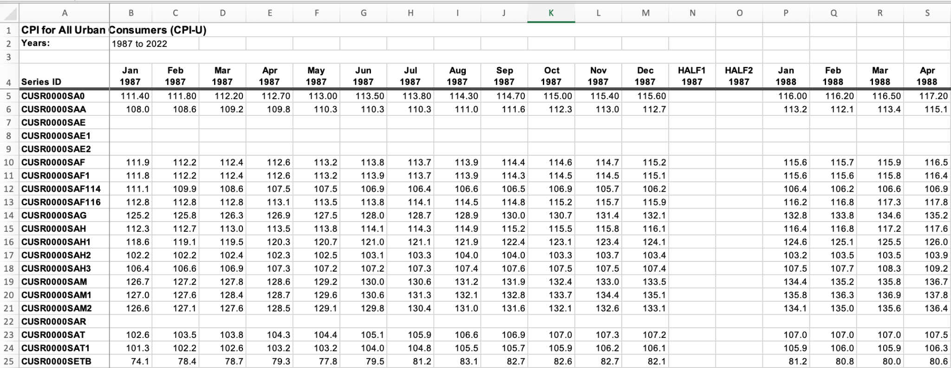
Pulling Data
Identify Region and Items you want to pull data for
Export to Excel, modify date columns to read as dates and pivot into rows

Slide 6
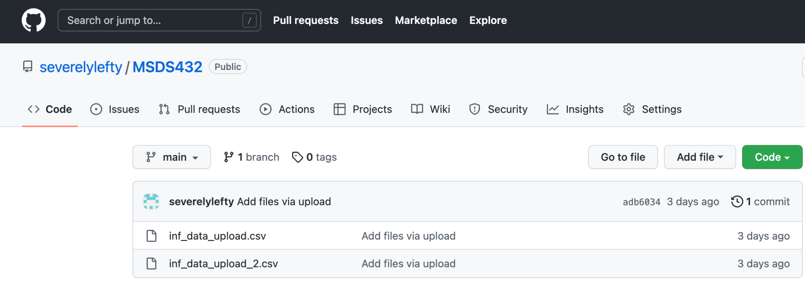
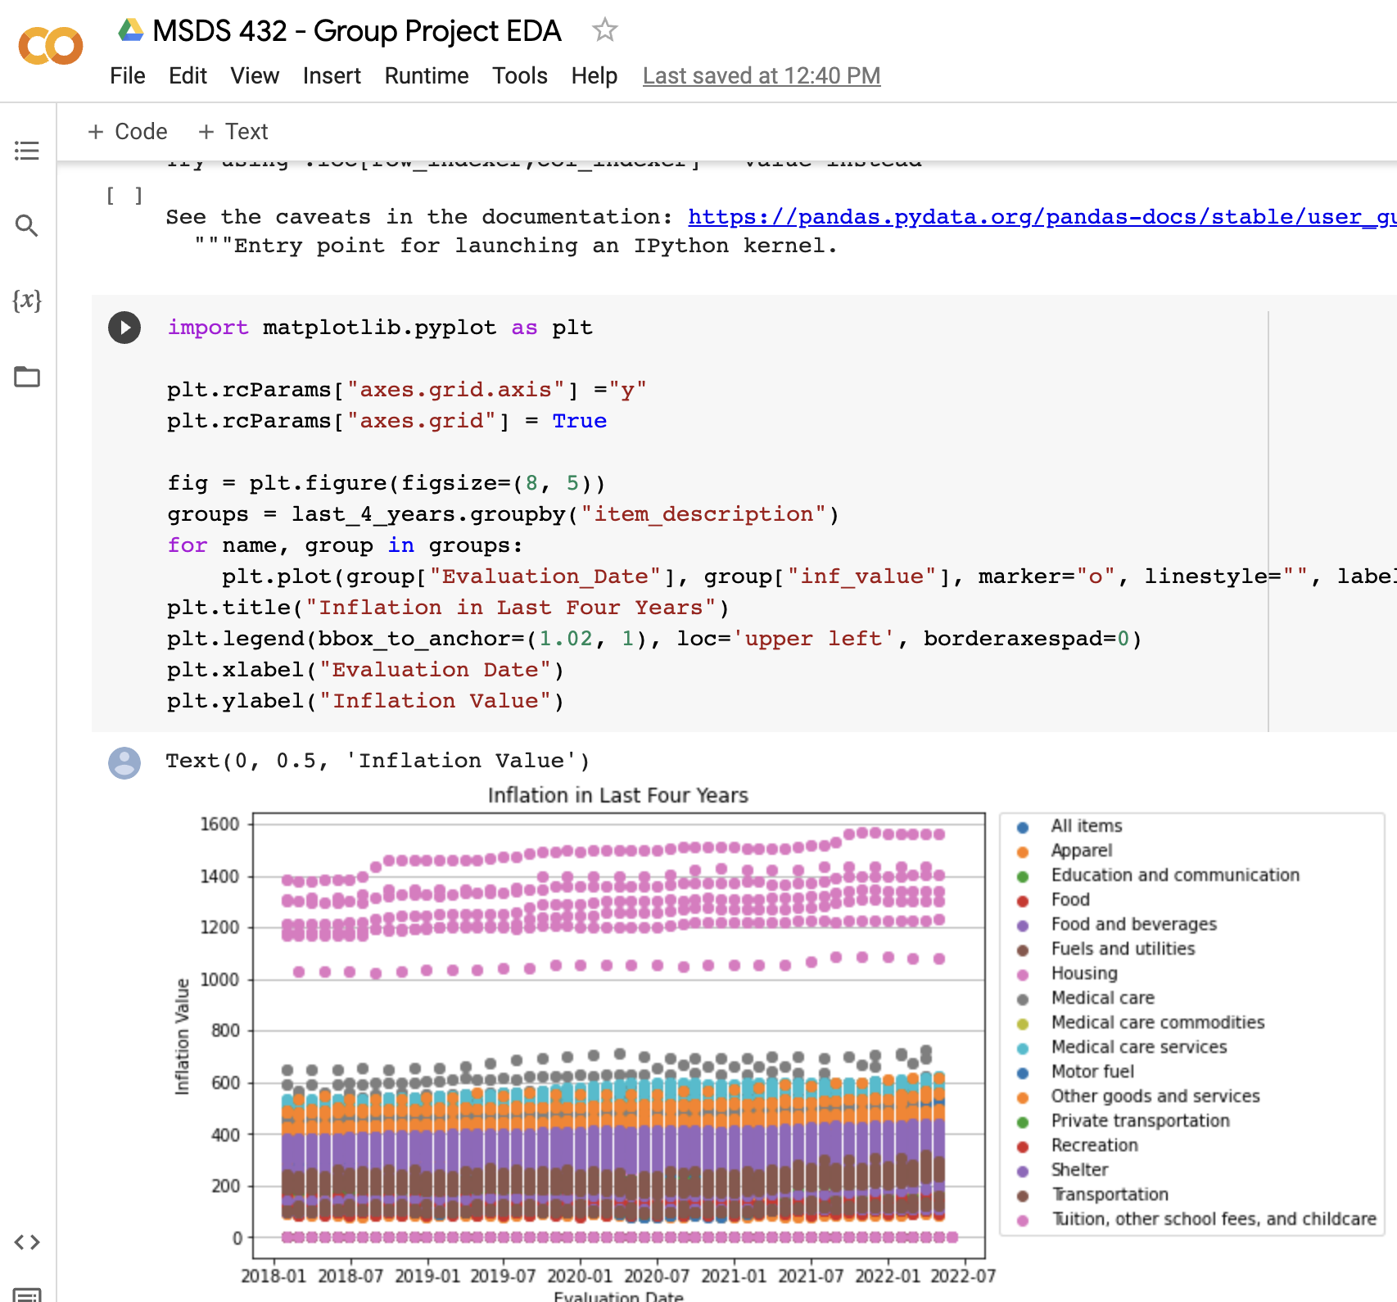
Performing EDA
Create GitHub repository and load data. Given size of data, two separate files had to be created and uploaded.
Clone repository to Google Colab so all team members can work on same set of code and same set of data off the same workbook.

Slide 7
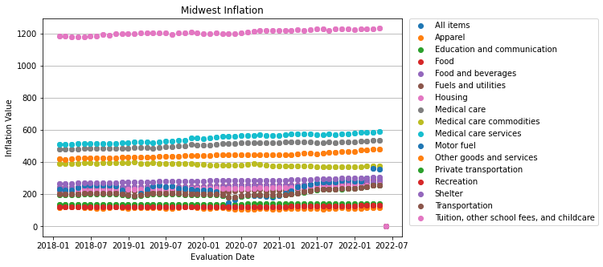
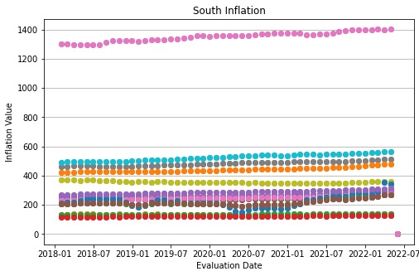
Inflation by region over time
Legend
Observations:
The overall inflation trends are similar between the south and midwest regions with categories like recreation remaining relatively stable and categories like fuel having more fluctuation.

Slide 8
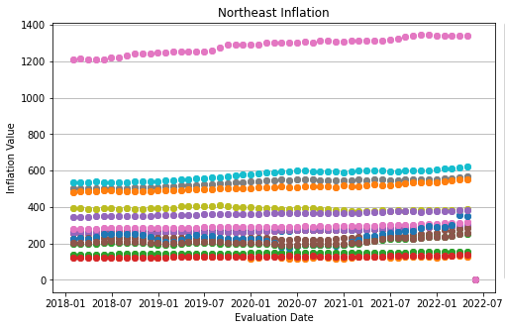
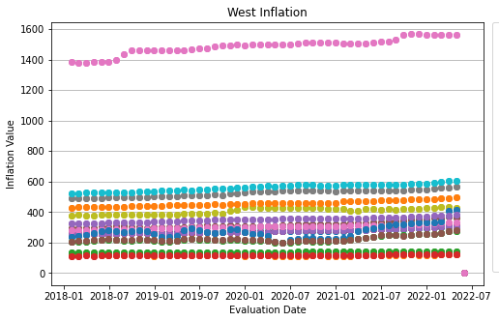
Inflation by region over time, 2
Legend
Observations:
In the past 4 years, the inflation trends in the west and northeast regions follow the same general patterns observed in the south and midwest regions. However, the northeast and west appear to have a more drastic increase for housing.

Slide 9
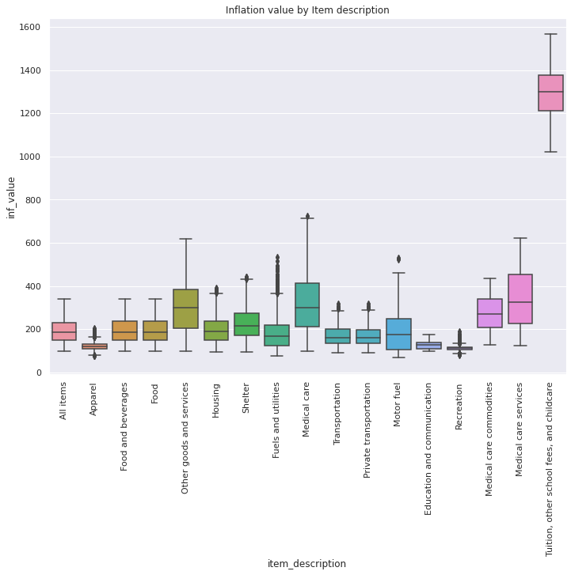
EDA Interpretation
This boxplot of inflation values more clearly shows the variation in inflation rates for different categories. Apparel and recreation, for example, have a more narrow spread and seem more resistant to inflation. Meanwhile Medical Care has a wider range of values indicative of the breadth of services and susceptibility to inflationary pressures.
“Other goods and services”, the category company ABC’s product would fall under, is one of the categories more impacted by inflation.

Slide 10
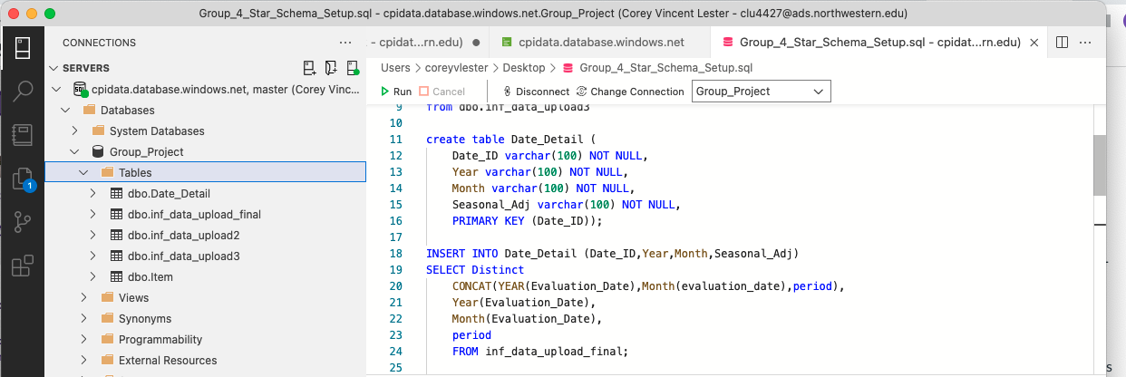
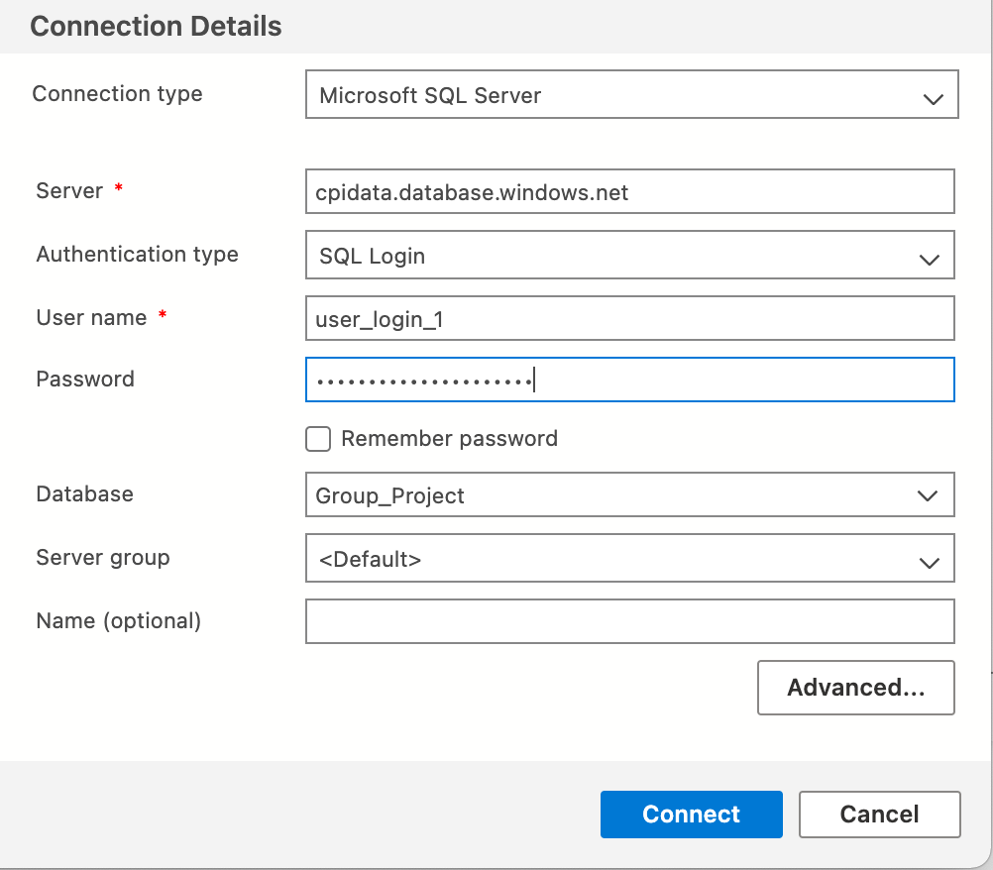
Build and Host Data on Azure
Create a SQL server, database, and storage account on Azure and utilize Azure Data Studio to build model
A user account (user_login_1) was created with db_owner permissions allowing for all team members to access and modify the database as needed

Slide 11
Learning Experiences
Positive Experiences
Pulling the data was easy to do and export on BLS
Cloning a GitHub repository onto Google Colab proved to be a very efficient way to work together on exploratory data analysis without trouble accessing the same data
Negative Experiences
Time was lost trying to build the data model on MySQL workbench and host on Google cloud
FRED data proved too difficult to blend with BLS data
Going back to Week 1, what would we do differently?
Perhaps identify a different problem statement as inflation data didn’t offer the depth and breadth as other approved datasets.
Pivoting the data in excel (while easy to do) is not a practical thing to do in professional environments.

Slide 12
Appendix
Changes to Data Model and Source-to-Target
After submitting the original Data Model and Source-to-Target Mapping we gained a greater understanding of the data we were working with necessitating changes to the original proposal. Examples:
Adding subregion to location table and subgroup to item table
Removing state from model as BLS dataset had various record that crossed multiple state lines
Addressing NULL records
Pulling data by region yielded blank records for certain items and months. After pivoting the data in excel, these records were saved and loaded into GitHub as zeroes. These “null” records were removed from EDA and the final data model.
Accessing Azure database
Server name: cpidata.database.windows.net
Log-in credentials will be provided with project submission

